Slide 1
Dear PHACS Abstract Author :
Congratulations on the acceptance of your abstract as a presentation. Following are some guidelines for PHACS authors to facilitate the process of presentation development.
To maintain consistency among PHACS presentations and to increase the profile of the study, PHACS maintains this presentation template, which all PHACS authors are encouraged to use. The color scheme and layout are left to your discretion, but please be sure to include the PHACS logo and the acknowledgements that can be found on the last two slides of this template.
Drafts should be circulated to all co-authors at least 10 days prior to the conference. Co-authors should be given 1 week to respond with comments.
Prior to the conference, the final version must be sent to the relevant Working Group(s) and the Scientific Leadership Committee (SLC). This is for informational purposes only – no comments or corrections will be solicited at this time from these groups.
The PHACS DRC and HECC are available to assist with graphics and layout. If you would like to take advantage of this service, please send to phacs@hsph.harvard.edu at least 3 weeks before the conference.
The first author is responsible for all costs associated with the presentation. Under exceptional circumstances, the PHACS Leadership may provide funding, and authors should submit such requests to phacs@hsph.harvard.edu.
Sincerely,
The PHACS Leadership

Slide 2
CONFLICT OF INTEREST

Slide 3
Presenting Author(s)
Co-Author(s)
For the Pediatric HIV/AIDS Cohort Study
Conference Name | Date

Slide 4
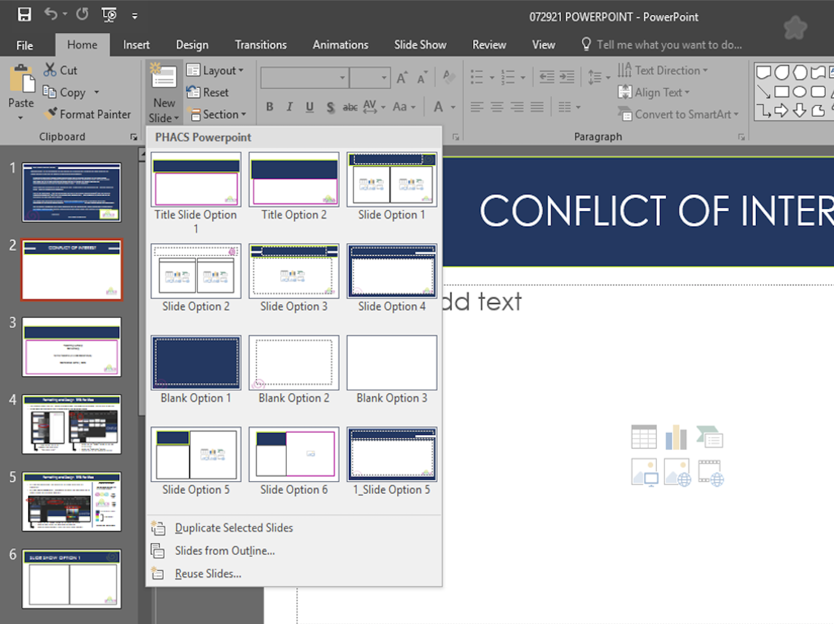
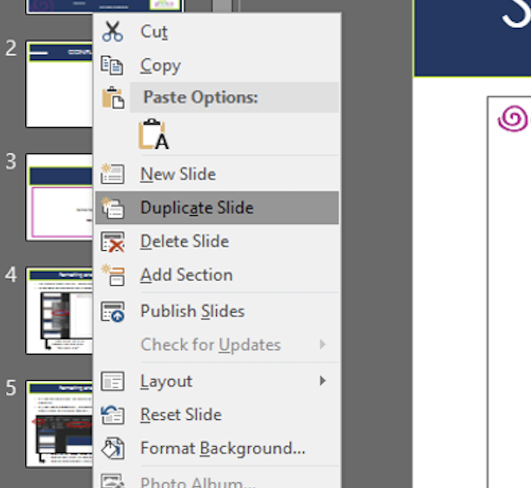
Formatting and Design TIPS: FOR PC
The following format slides are options to choose from, any combination/number can be used or omitted.
To add more pre-designed slides – follow either of the two options below:
RIGHT CLICK any of the
example slides and select “DUPLICATE SLIDE”
CLICK the the “HOME” button at the top of the screen
CLICK the “NEW SLIDE” button
Choose any the pre-approved designs

Slide 5
Formatting and Design TIPS: FOR PC
All slides can be adjusted, but please use the theme colors and text characters.
All slides should automatically incorporate the preset font and colors. But to access PHACS font and colors manually:
ELEMENT REFERENCE
Feel free to copy and paste any of the following elements.
LOGO ELEMENT
(PNG)
PHACS LOGO
(PNG)
: TEXT/BACKGROUND COLOR
: THEME COLORS
CLICK the the “HOME” button at the top of the screen
ACCESS FONT under the FONT COLLECTIONS bar
ACCESS PHACS COLORS under font color THEME COLORS
TITLE/TEXT FONT: Century Gothic

Slide 6
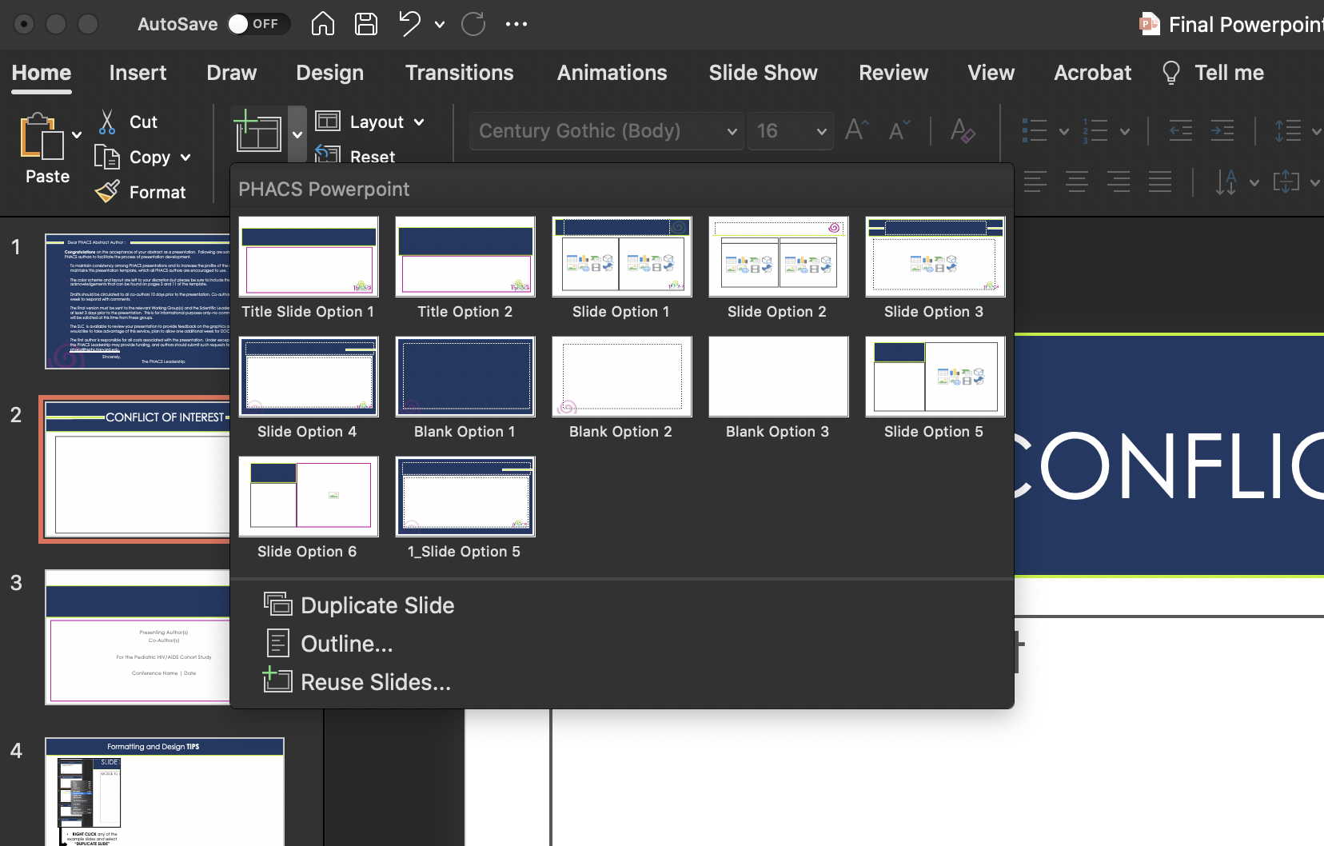
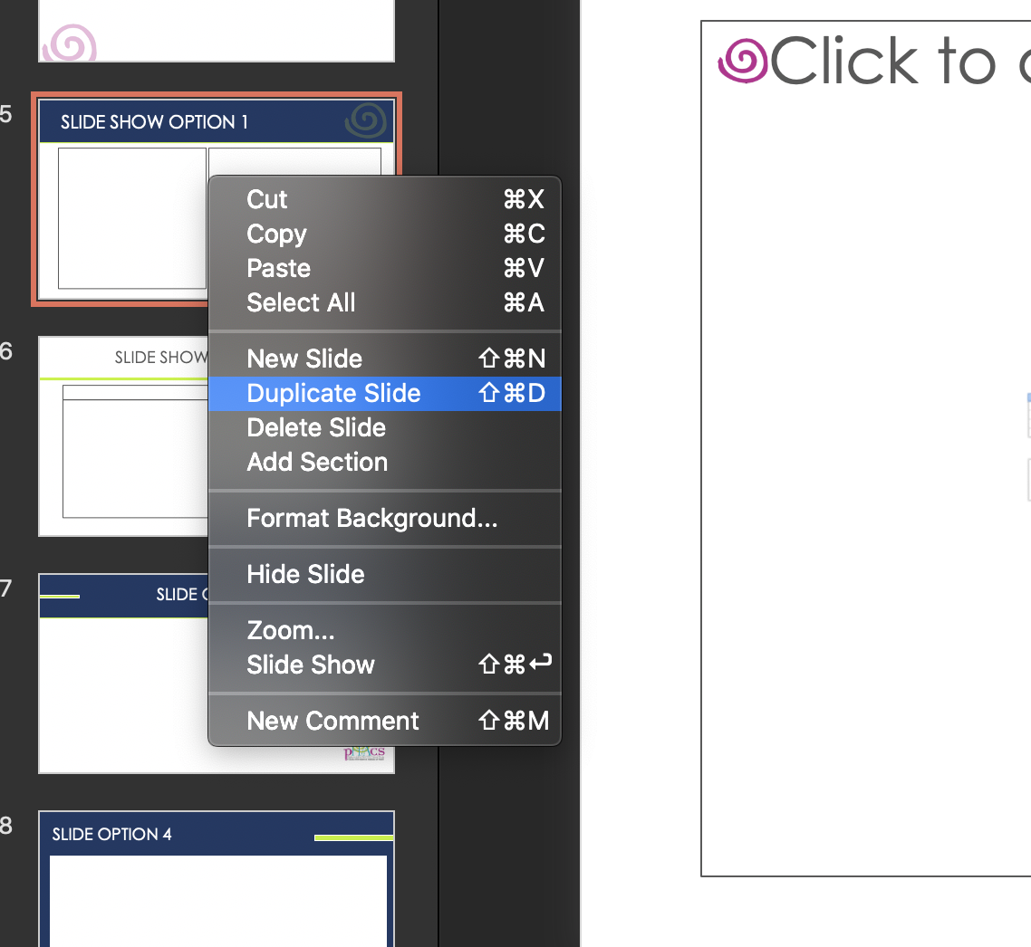
Formatting and Design TIPS: FOR MAC
The following format slides are options to choose from, any combination/number can be used or omitted.
To add more pre-designed slides – follow either of the two options below
RIGHT CLICK any of the
example slides and select “DUPLICATE SLIDE”
CLICK the the “HOME” button at the top of the screen
CLICK the “NEW SLIDE” button
Choose any the pre-approved designs

Slide 7
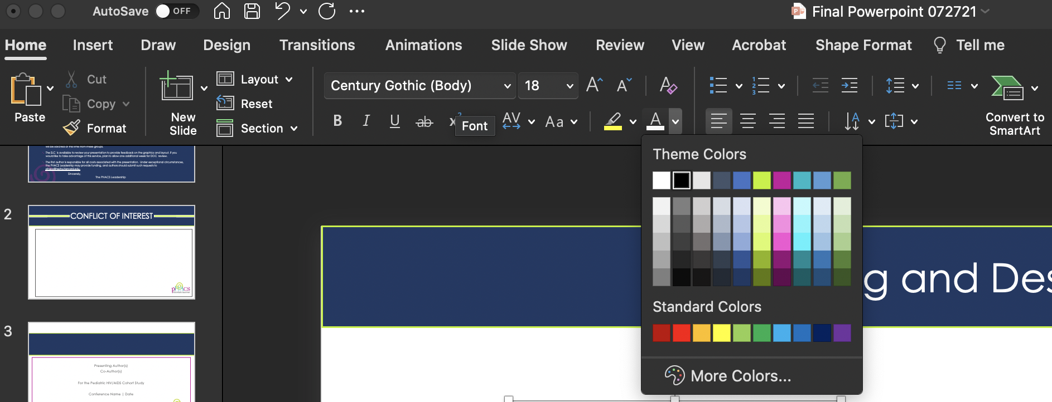
Formatting and Design TIPS: FOR MAC
ELEMENT REFERENCE
All slides can be adjusted, but please use the theme colors and text characters.
All slides should automatically incorporate the preset font and colors. But to access PHACS font and colors manually:
Feel free to copy and paste any of the following elements.
LOGO ELEMENT
(PNG)
PHACS LOGO
(PNG)
: TEXT/BACKGROUND COLOR
: THEME COLORS
CLICK the the “HOME” button at the top of the screen
ACCESS FONT under the FONT COLLECTIONS bar
ACCESS PHACS COLORS under font color THEME COLORS
TITLE/TEXT FONT: Century Gothic

Slide 8
SLIDE SHOW OPTION 1

Slide 9
SLIDE SHOW OPTION 2

Slide 10
SLIDE OPTION 3

Slide 11
SLIDE OPTION 4

Slide 12
SLIDE OPTION 5

Slide 13
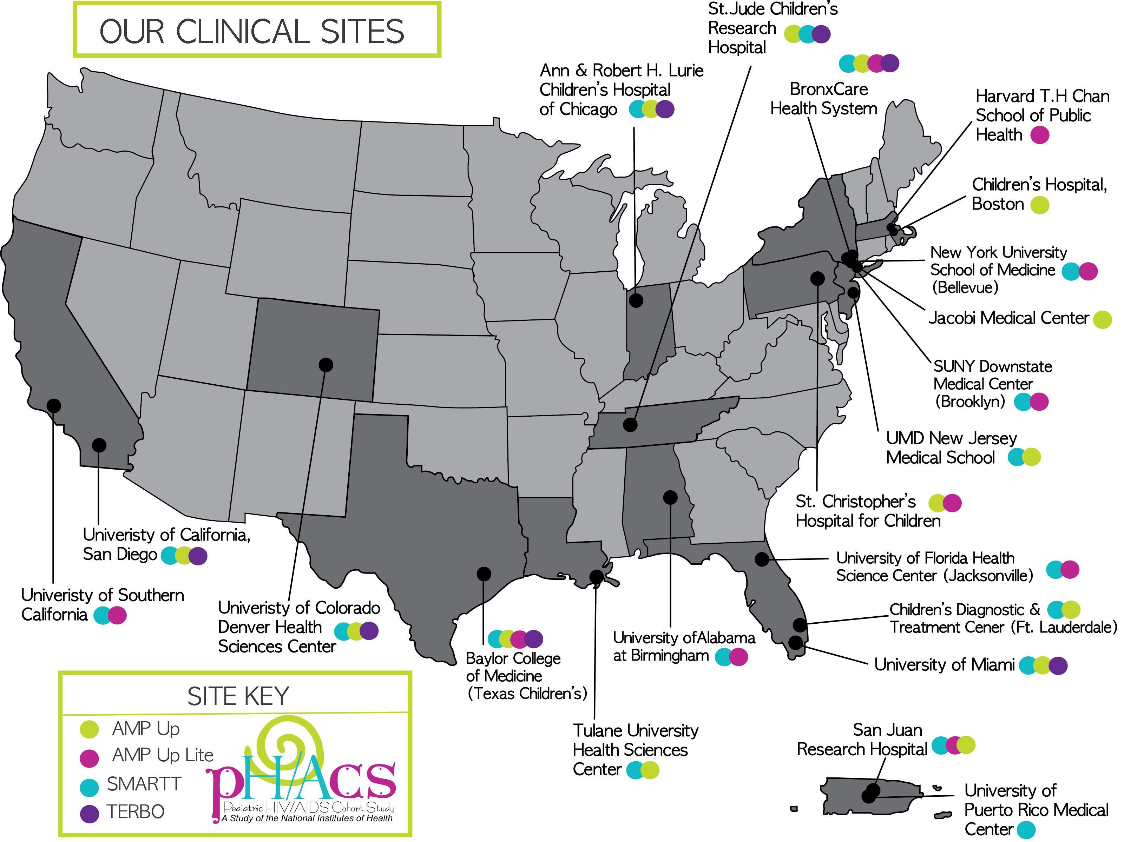

Slide 14
Past and Current PHACS US Clinical Sites
Ann & Robert Lurie Children’s Hospital of Chicago
Baylor College of Medicine
BronxCare Health System
Children's Diagnostic & Treatment Center
Children’s Hospital, Boston
Children’s Hospital of Philadelphia
Harvard T.H. Chan School of Public Health
Jacobi Medical Center
New York University School of Medicine
St. Christopher’s Hospital for Children
St. Jude Children's Research Hospital
San Juan Hospital/Department of Pediatrics
SUNY Downstate Medical Center
SUNY Stony Brook
Tulane University Health Sciences Center
University of Alabama, Birmingham
University of California, San Diego
University of Colorado Health Sciences Center
University of Florida/Jacksonville
University of Illinois, Chicago
University of Maryland, Baltimore
Rutgers- New Jersey Medical School
University of Miami
University of Southern California
University of Puerto Rico Medical Center

Slide 15
Acknowledgments
PHACS is funded by:
Under cooperative agreements HD052102 (Harvard T.H. Chan School of Public Health), HD052104 (Tulane University School of Medicine), and P01HD103133 (Harvard T.H. Chan School of Public Health for the Pediatric HIV/AIDS Cohort Study (PHACS) 2020).
We thank the study participants, clinical sites, PHACS Community Advisory Boards, Frontier Science, and Westat.

